Slide 1
ML Formulation and Baselines
Rayid Ghani and Kit Rodolfa

Slide 2
Short Quiz on Video and Reading

Slide 3
Things to remember
Due tomorrow: ACS data loading assignment
Coming up next week:
Weekly review (before class on Tuesday)
Review slides on github for ML Pipelines (for Tuesday)
Group project proposal due next Friday
Time for group work on Wednesday and Thursday

Slide 4
Scope
Data
Exploration
Modeling
Get Data
Store Data
Link Data
Rows
Features
Labels
Model Selection
Train-Test Splits
Performance Metrics
Model Interpretation
Entities
temporal
Spatial
…
Models
Dealing with Bias and Fairness
Field Trial Design
Deployment
Monitoring
Goals, Actions, Data, Analysis, Ethics

Slide 5
Any questions from the video lecture?

Slide 6
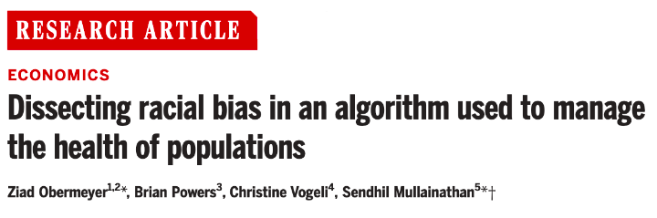
BREAKOUT SESSION
http://bit.ly/mlpp-health-bias

Slide 7
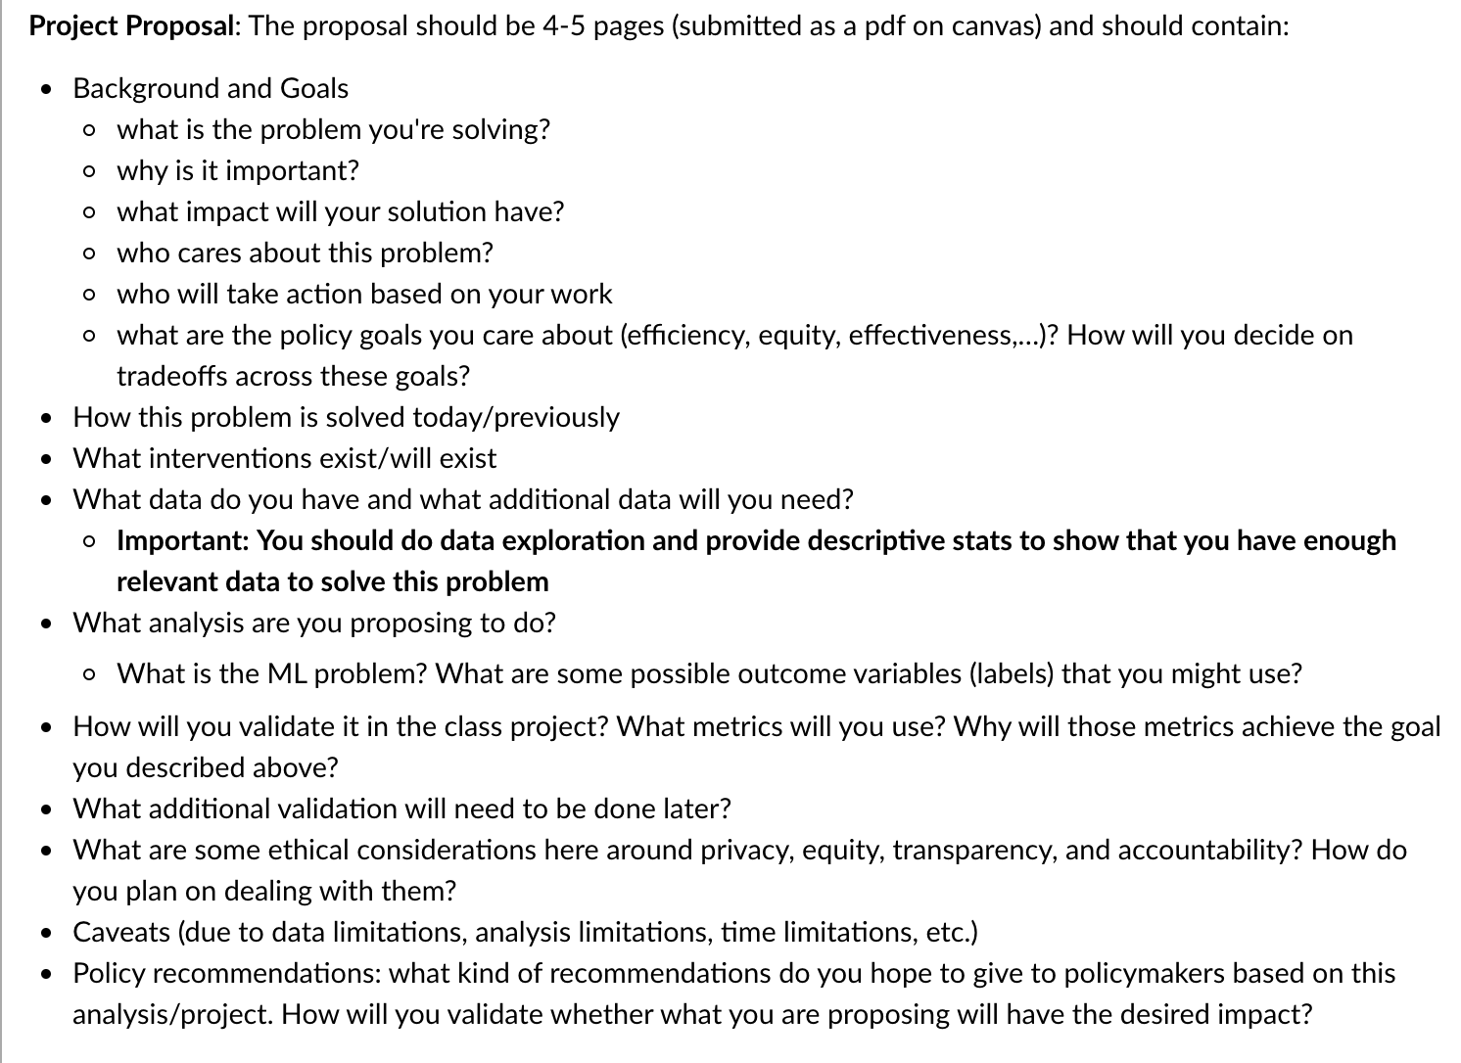

Slide 8
Things to remember
Due tomorrow: ACS data assignment
Coming up next week:
Weekly review (before class on Tuesday)
Review slides on github + Reading for ML Pipelines (for Tuesday)
Group project proposal due next Friday
Time for group work on Wednesday and Thursday

